Slide 1
Solutions Overview

Slide 2



Agenda
About Us
Solutions Overview
01
Test Automation
ATAF
AccessBot
02
Live Demo
Case Studies
03

Slide 3
ABOUT US

Slide 4
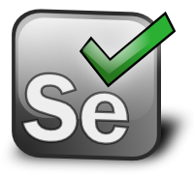
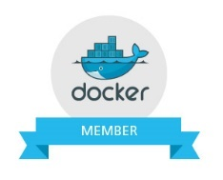
About Us
    Independent Software Testing Solutions Company
    Headquartered in Ellicott City, MD
    60+ FTEs in USA and over 50 resources in Offshore centers
    GSA IT Schedule 70 GS-35F-313DA
    Official Docker Partners
    Sponsor of Selenium WebDriver Project
    Team of Architects from Google, Paypal and Amazon
    30,000+ hours of Federal and State government experience over last 5 years
    60,000+ hours of experience in BFSI, Retail and Healthcare domains
    50% workforce has over 10 years experience in Federal and State projects
    Implementing Test Automation at CMS as a Sub Contractor for 3 contracts
    Teamed with CGI and Northrop Grumman for ITSSC-II IDIQ for SSA
    Teamed with CSRA for SSA ITSSC contract
    Implementing Test Automation at FDA as a Sub Contractor with Leidos
    Implementing Agile/DevOps Testing solutions for various BFSI customers

Slide 5
Solutions Overview
Performance Engineering
Accessibility Testing
TestBot
AccessBot
Test
Automation
Services
Deployment Automation
ATAF
Solutions
DeployNow
Build Automation
Continuous
Delivery
BuildBot
DockerStack

Slide 6
Our Focus

Slide 7
Our People
100%
HP Toolset Experts Experience with HP ALM, HP UFT, HP LoadRunner
DevOps tools
Chef, Puppet, Nagios, Splunk etc
30%
Open Source Experts
Selenium, Jmeter, Jenkins etc
50%
80%
ISTQB/CSTE Certified Testers
Our people are career testers

Slide 8


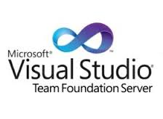



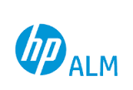




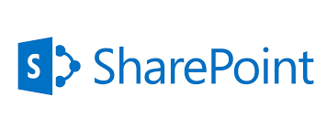
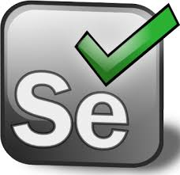
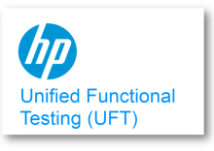
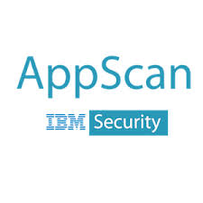

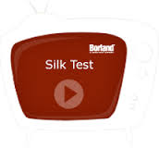





Our Tool Expertise
ALM and Collaboration Tools
Test Management and Defect Management Tools
Tool Capabilities
Security and 508 Compliance
Test Automation

Slide 9
TEST AUTOMATION

Slide 10
Test Automation
Manual Functional Testing
Automated Functional Testing
Continuous Testing with ATAF
4-6 weeks test cycles*
Slow agile SDLC
Limited Coverage and Collaboration
1-2 week test cycles*
Better agile SDLC speeds
Increased Coverage and Collaboration
Daily/Nightly as part of Dev builds
Increased test coverage and collaboration with Bas, Dev and QA team
*typical efforts

Slide 11
Agile Test Automation Approach
Iterative design
Understand
User Story
Prototype
Rinse & Refine
Integrate
User Testing
Weekly Iterations
Agile Activities
Development Team
Understand requirements and analyze existing code base to add/update code
Design prototype, build user interface controls, develop code and unit test cases
Unit testing, integration testing and do bug fixes
Bug fixes and continuous integration testing
Understand requirements and analyze existing test cases and user flows
Learn user interface controls, write application specific keywords, pseudo code and business processes, also identify test data needs
Build test cases using keywords and business processes template
Execute test cases and reporting defects
Manual Test team
Work As One Team
Analyze existing automation suite to add/update
test cases
Write physical properties for each user interface control, develop automation code for pseudo codes and identified business processes
Validate the above template using automation engine
Support manual testing team to fix case issues
Automation test team

Slide 12















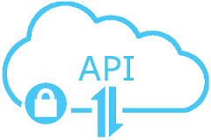
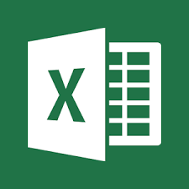





Agile Test Automation Framework
Integrates with multiple CI Servers and build tools
Integrates with Agile Management tools
Support for multiple languages C#, Java, Ruby, JS
Integrates with ZAP Security framework from OWASP
Cross Browser/OS support
Uses Java, Junit, Maven, Selenium and Cucumber
Customized HTML reports
Plug and Play Accelerators
Continuous Delivery/Testing
Key Highlights
UNIT
API
GUI
Sec. 508
Security
Build Process
Desktop
BDD/TDD
Feature Definition
Unit/API Step Defs
GUI Step Defs
Configuration
Test Controller
Reports
Agile Tools
Mobile
Accelerators

Slide 13
CASE STUDIES

Slide 14
Test Automation for Federal Client CMS (ACA Contract)
Complex application with integration to multiple backend systems with over 10,000 test cases
Over 35 million transactions in real world
No best practices and framework structure for test automation
Tests were not integrated with the CI servers to trigger tests from
Issues with SauceLabs Integration to run parallel tests on multiple OS/Browser combinations
Lack of test coverage, the coverage was only 20%
Valsatech adopted a phased approach to execute the engagement with 1 Test Architect and 5 Automation Engineers
Created end to end business scenarios from test cases to achieve better automation coverage, using Selenium, TestNG and Java
Designed a robust Test Automation Framework leveraging Valsatech’s Accelerators and ATAF
Automated test scripts by leveraging reusable libraries to accelerate the automation
Provided a solution to interact with SauceLabs REST APIs to trigger an email from inside the VMs to retrieve downloaded pdfs
Key Challenges / Business Drivers
Solutions Provided
Improved test maintainability by leveraging Valsatech’s ATAF
Increased test coverage by over 50%
Reduced test automation efforts by 40% by leveraging existing reusable libraries
Integration with Jenkins CI Server
Key Benefits Delivered

Slide 15
Test Automation for Financial Client – Barclays Bank (Delaware)
Web application to allow users to apply for new credit cards, with millions of transactions per month
Technology stack includes Java/J2EE, XML, SOAP/RESTful, Oracle DB, TSYS and Go build pipeline
Test Automation started from scratch to accelerate the testing efforts
A regression suite of 500 test cases to be automated
4 different agile teams with over 50 people
Web services test automation
Valsatech added 4 Software Development Engineers in Test(SDETs) to support the test automation
Created a test automation framework with Selenium, TestNG, Ready API and SOAPUI
Leveraged the existing Accelerators from Valsatech’s ATAF framework
Provided integration with Go build pipeline tools for Conitnuous Integration
Key Challenges / Business Drivers
Solutions Provided
Improved test maintainability by leveraging Valsatech’s ATAF
Achieved the goal of automating the 500 test cases in 3 months
Reduced test automation efforts by 40% by leveraging existing reusable libraries for both Selenium and API/Web Services testing
Key Benefits Delivered

Slide 16
Test Automation for HealthCare Client – United Health Care
New web application being built to use across the wide network United Healthcare, to provide healthcare solutions to users
Technology stack includes Groovy, Spock, Jenkins, Geb, Docker and Java 8.0
More than 20,000 test cases to be automated
The key goal of automation was to achieve automation for the 20,000 test cases and run them as part of the daily CI cycle
Valsatech added 4 Software Development Engineers in Test(SDETs) to support the test automation, with 14 people already in place
Created a test automation framework with Geb and Groovy
Created reusable libraries as part of the Geb/Groovy framework which could be used for browser automation and Web services automation
Spun up Docker containers as part of the test automation workflow to run the tests in Docker containers
Integrated with Jenkins as the CI tool of choice
Key Challenges / Business Drivers
Solutions Provided
Created reusable libraries to be used for automation of 20,000 test cases
Currently running the automated tests as part of the daily CI cycle
Creating more automation tests to increase coverage of test automation
Key Benefits Delivered

Slide 17
AccessBOT

Slide 18
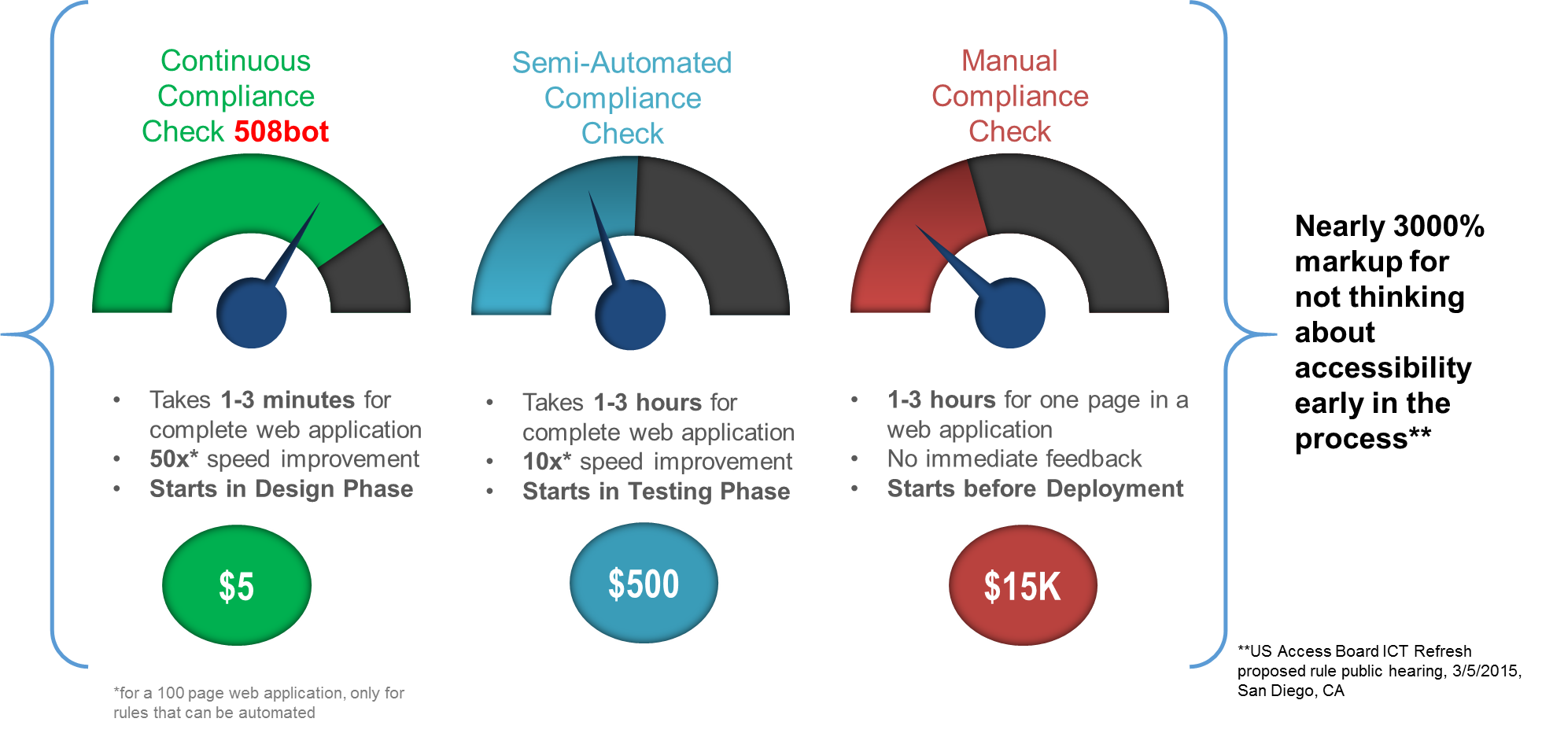
Automated Accessibility Testing

Slide 19
AccessBOT Features
Scan websites for Accessibility issues
WCAG 2.0, Section 508 and ADA Compliance ruleset
Scan dynamic web pages and forms
Configurable rules engine for future changes in compliance guidelines
Configurable Reporting Engine to define priorities
Easy to understand reporting
Web UI Interface and REST APIs
Integration with CI servers and DevOps lifecycle for instant feedback
Website scan scheduling
Integration with tools and frameworks such as Selenium, Jmockit, Cucumber, TestNG
Basic Features
Advanced Features

Slide 20
Contact Information
Corporate Headquarters
8726 Town and Country Blvd,
Suite #202 Ellicott City MD, 21043
Telephone: +1 443-761-0655
FAX: + 1 443-288-2222
E-mail: info@valsatechcorp.com

